Slide 1
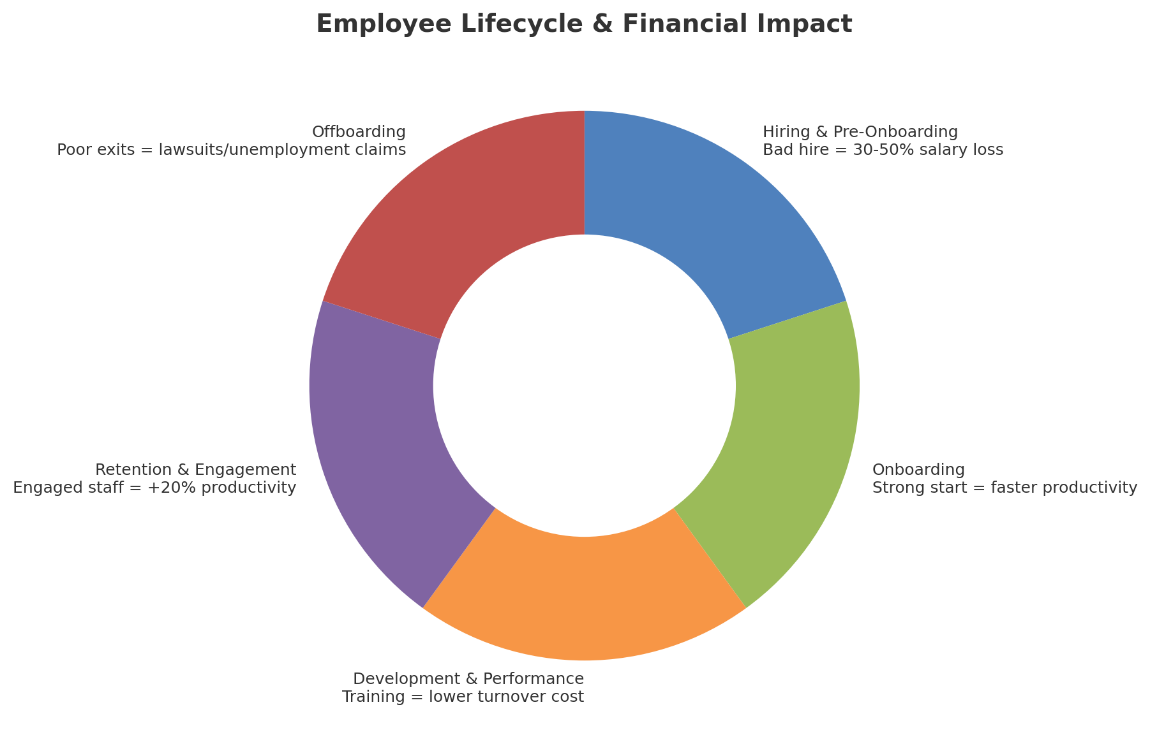
HR AS a Growth Engine
Facilitator: Arely Lagunas, Founder
Evolve HR & Leadership Consulting

Slide 2
Welcome
Why I started Evolve HR & Leadership Consulting
HR Strategic Partner to guide you as your business grow while staying protected
Today: Practical ways to strengthen your people practices (strategy) and your bottom line

Slide 3
The Employee Lifecycle & Why It Matters Financially
Hiring & Pre-Onboarding: Bad hires cost more than you think
Onboarding: Faster productivity = money back in your pocket
Development & Performance: Training/feedback prevents costly turnover
Retention & Engagement: Engaged employees improve service and reputation
Offboarding: Structured exits reduce lawsuits and unemployment claims
Takeaway: Every stage impacts your financials

Slide 4
Employee vs. Contractor
Employee: works directly for your business; you control schedule and tools
Contractor: independent, controls delivery, often multiple clients
Misclassification risks: IRS/DOL

Slide 5
Employment Taxes
Payroll Tax Obligations:
- Federal income tax withholding
- State taxes (varies)
- FICA: Social Security + Medicare (split employer/employee)
- FUTA/SUTA: unemployment taxes

Slide 6
Compliance & Liability : Top risks for small businesses
- People Strategy
- Missing required federal/state posters
- Paid leave laws
Misclassifications
Overtime mistakes
Notes:
Disgruntled employee: Lawsuit

Slide 7
Wrap-Up & Q&A
HR builds a stronger foundation, not just compliance
Proactive investment in people practices protects your growth and prevents expensive missteps.
Questions & Discussion

Slide 8
Other: Resources & Events (2 minutes)
Manager Essentials Power Session (Dec 2025, In-person)
Expand to Lead Management Program (Oct 2025, Virtual, 6 months)

